Slide 1
Webscraper with Golang
By: Tony Yang, Dinesh Reddy Reddem, Rui Liu, Shahin Madani

Slide 2
Project Purpose
The objective of project is to create a tool to keep identify trend reversal in the technology labor market. The current fed policy is not favorable for the technology sector as a whole, as result big technology firms are reducing cost to weather through the winter.

Slide 3
Data Usage
This project stored a list of companies in a csv format file.
The queried data from CNBC api will be stored locally and then uploaded to Airtable.
The data quality functions will be applied to tables locally prior to upload.

Slide 4
Business Function
This will provide many main business functions:
Allow industry leaders to use the data points to their best interest in terms of human capital
Allow research to be conducted to identify trend in industry and provide better guidance to talents who are interested in technology
Allow school to cater their program to fit market demands

Slide 5
Tools Used
Data storage and visualization: Airtable
Compiler: VS Code

Slide 6
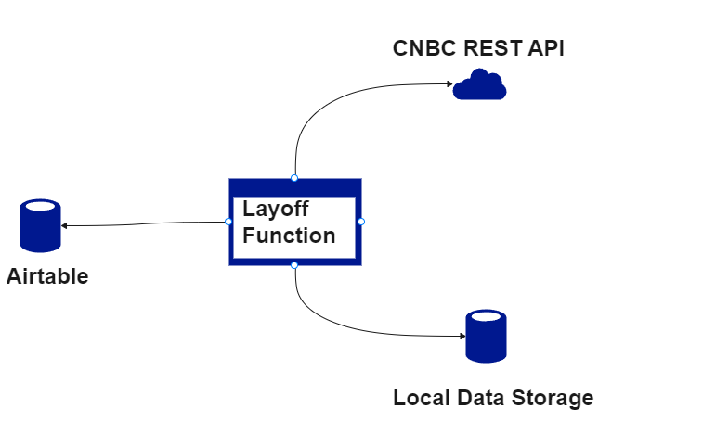
High Level Architecture

Slide 7
Future State Architecture
Utilizing to Azure cloud to run the web scraper
Create Canvas Applications from Power Platform to build front end user experiences.
Use Dataverse to store data on cloud.
Map data from dataverse to PowerBI to create dashboard showcasing data trend.
Power Automate to trigger process start at scheduled time.
Store scraper code in Power App, and utilize power automate to trigger scraper code.

